Slide 1
Drowning in data? How to use customer Experience Data to drive User Experience
Sean Cassidy and Jay Blumenthal

Slide 2


Hello!
Sean Cassidy
Jay Blumenthal

Slide 3
Agenda
Our evolving UX research approach (and why we had to adapt)
Developing a research program
Understanding your UX and CX data sources and how to use them
Example: The FAFSA form
Putting it into practice

Slide 4
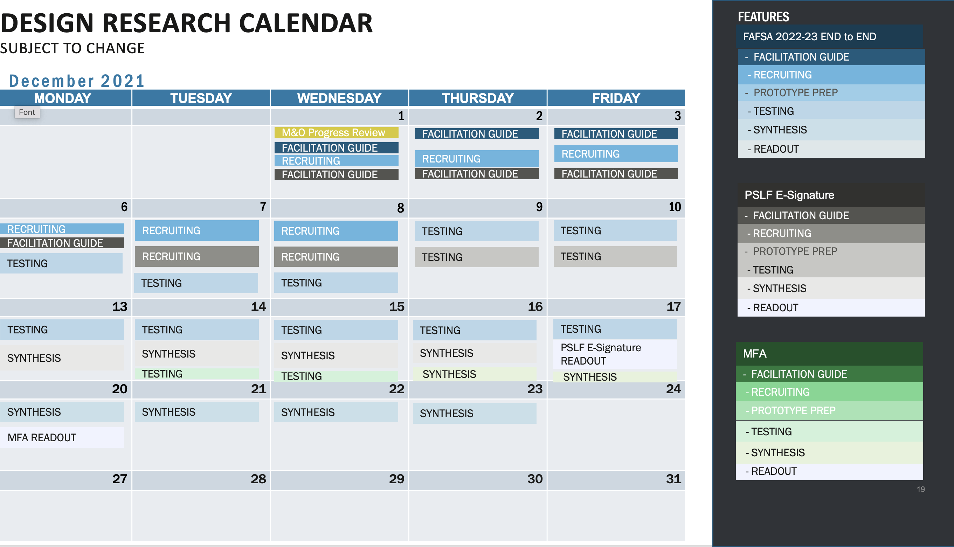
Our (Evolving) approach to research
Calendar: After running multiple studies at the same time, we realized that just doing usability testing wasn’t helping us understand our customers better.

Slide 5
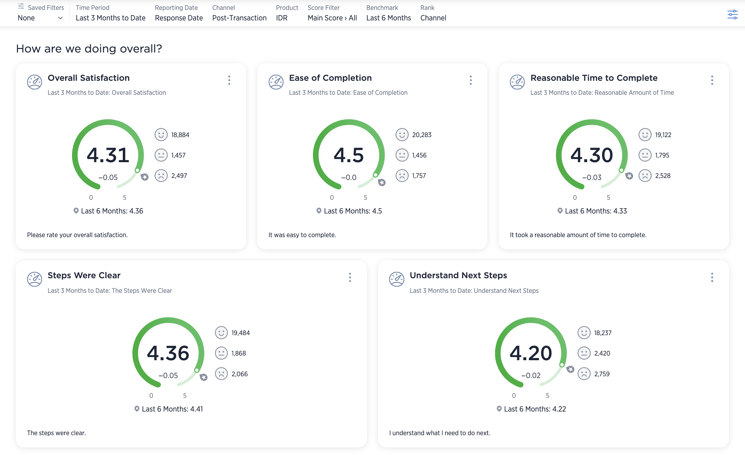
My product scores high in surveys, why do I need to do user research?
Post-transaction customer scores for the Income-Driven Repayment Plan Application n=23,778

Slide 6
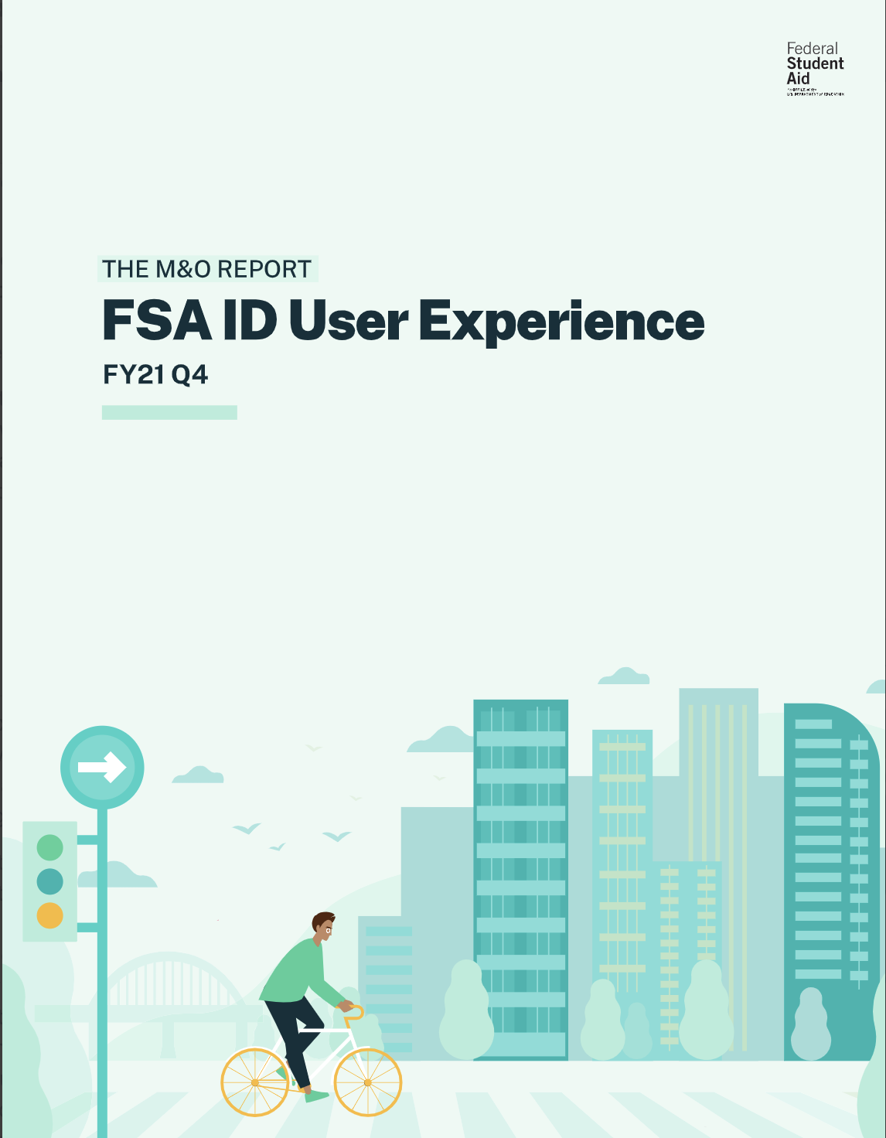
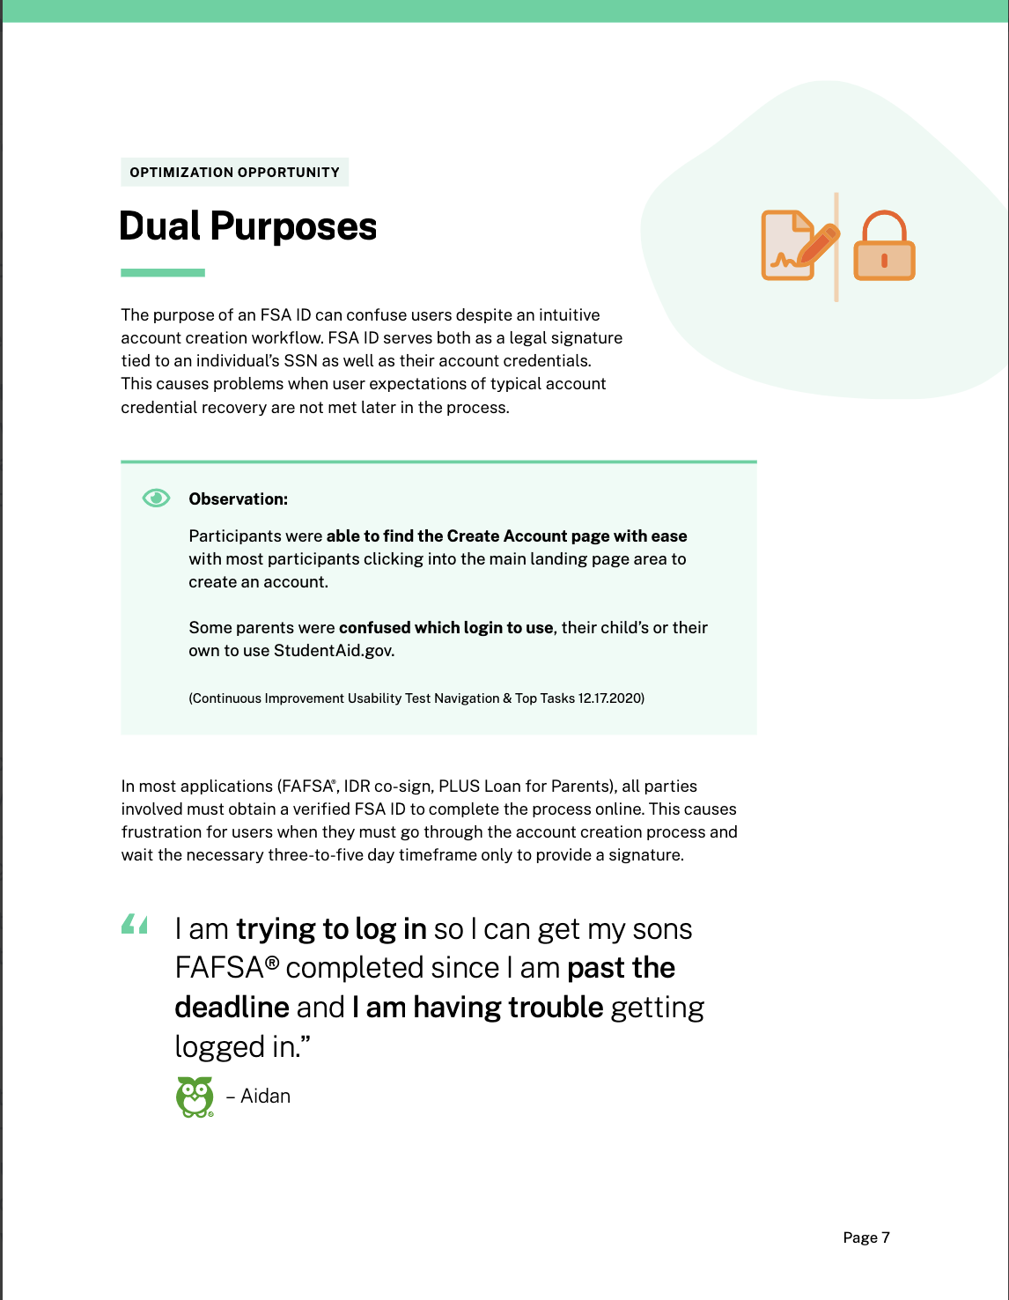
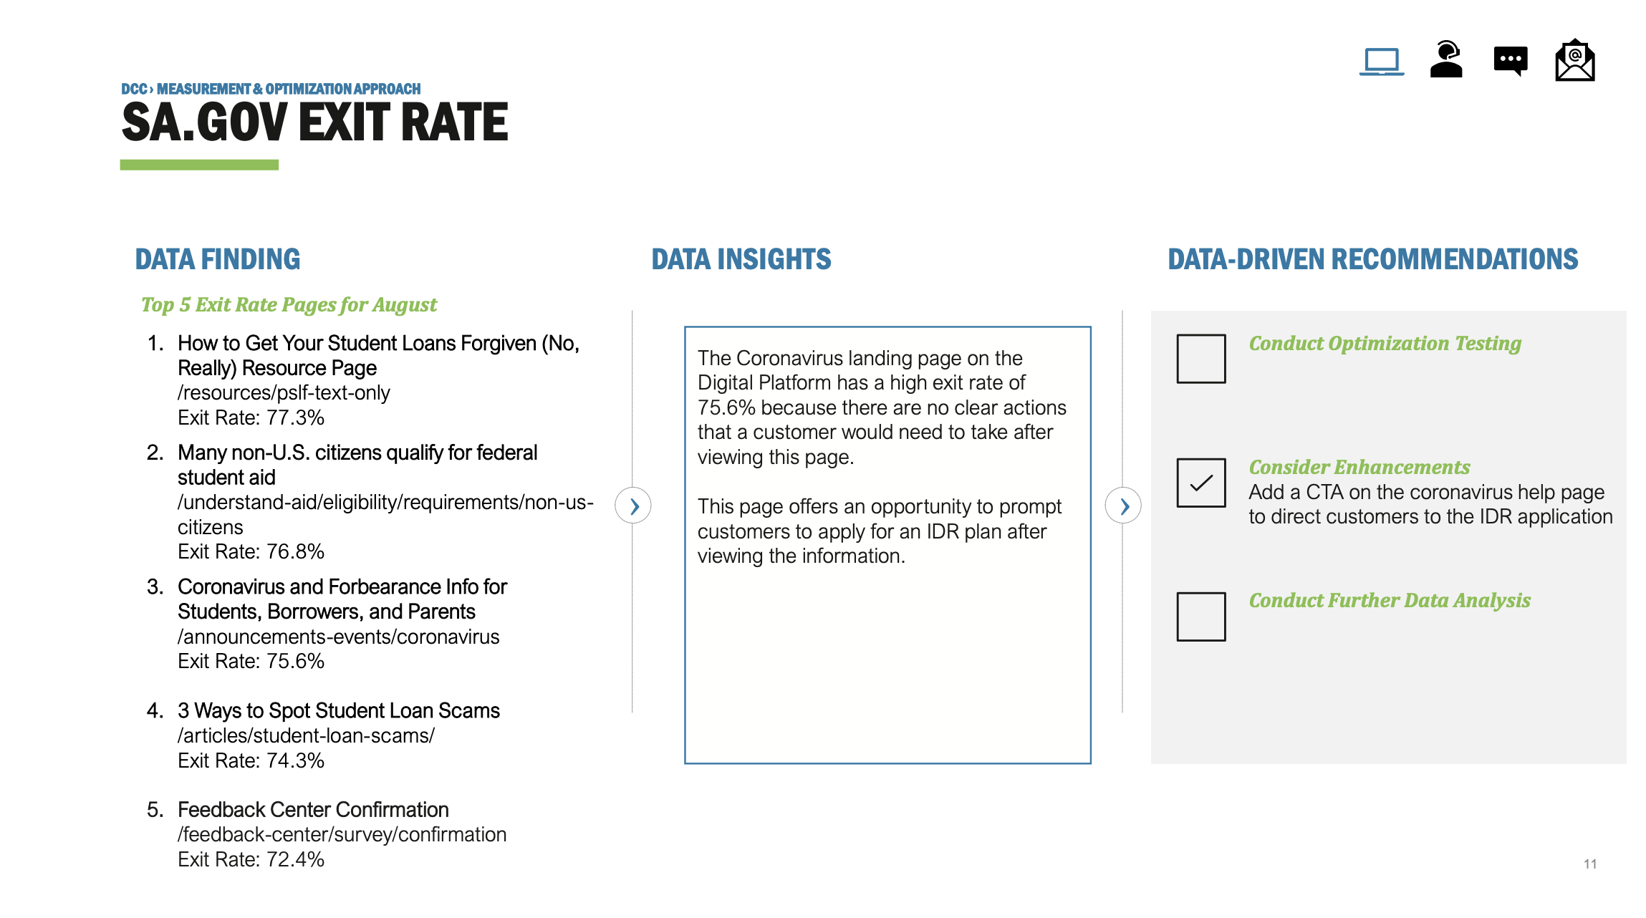
What we created
Previous effort: Too little time and too much focus on data like site visits that don’t tell you how your site is helping people.
Current effort: Narrative driven UX research insights utilizing
qualitative and quantitative data.

Slide 7
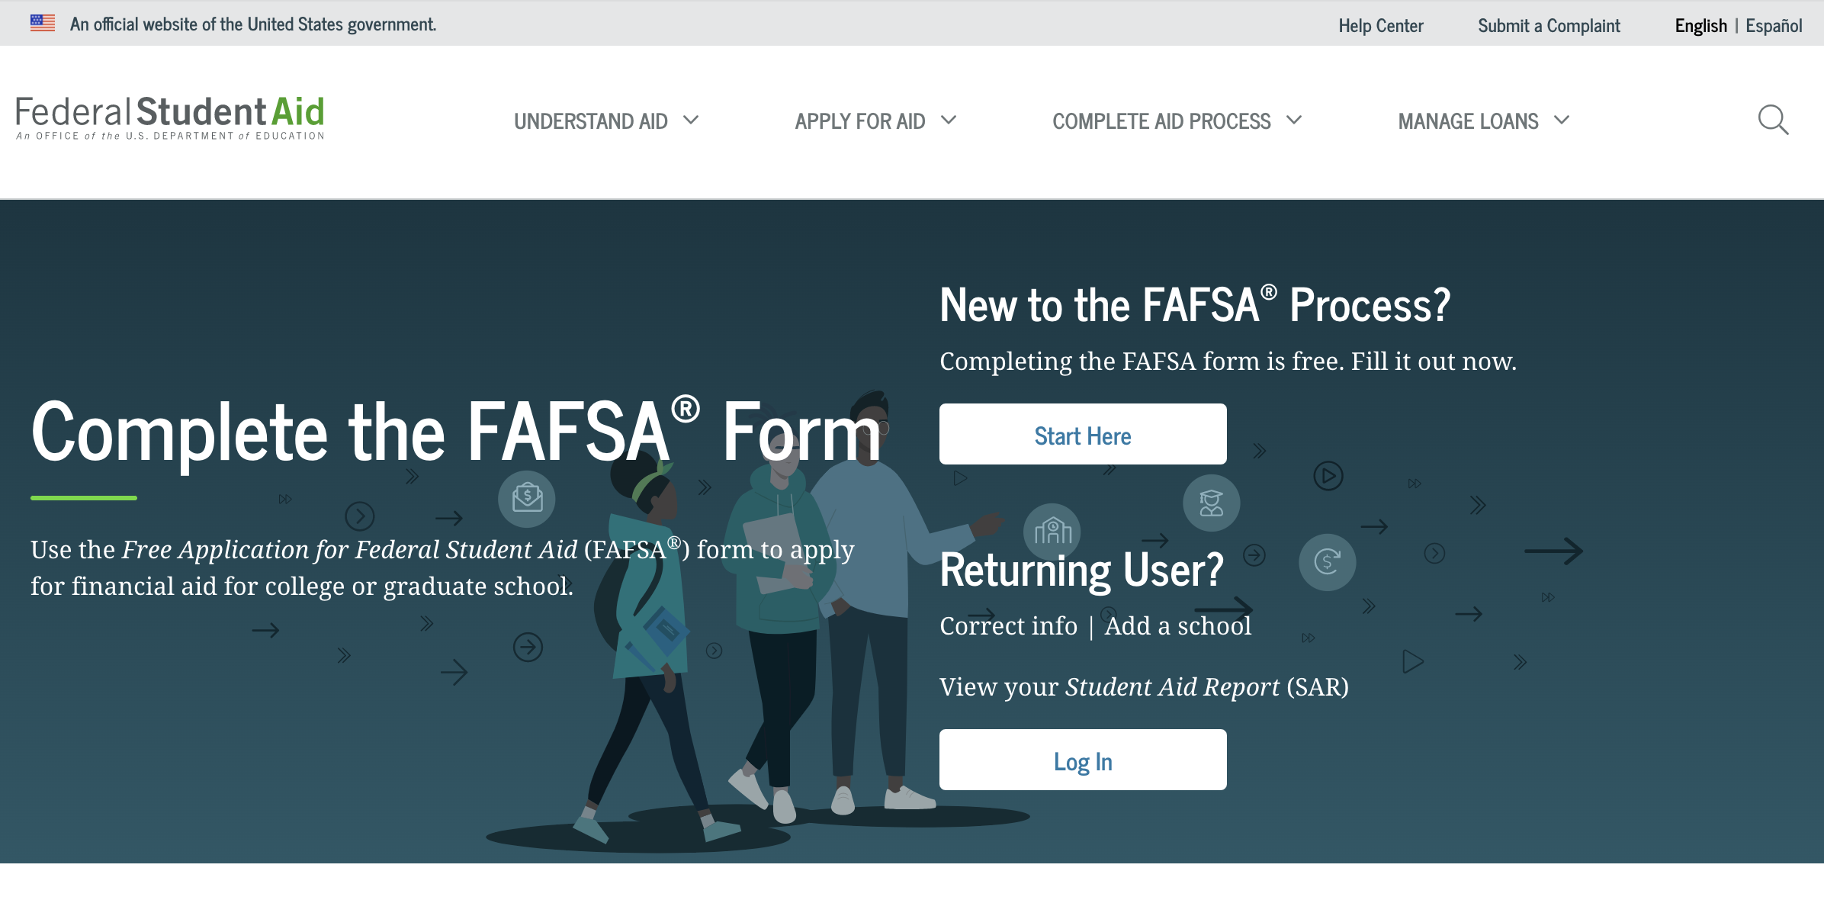
FAFSA® Form
What can you learn from a product your agency has managed for more than 20 years?
FAFSA® Form

Slide 8

Our Process
Gather CX Data Sources
Research: Plan, Conduct, Synthesize
Engage Stakeholders
Our process helps us engage with stakeholders at FSA to foster an understanding of students, parents, and loan borrowers’ needs and goals.
Share & Use Research
Make research accessible
Our Research Process: Allows us to use both qualitative and quantitative data together and engage stakeholders along the way.

Slide 9
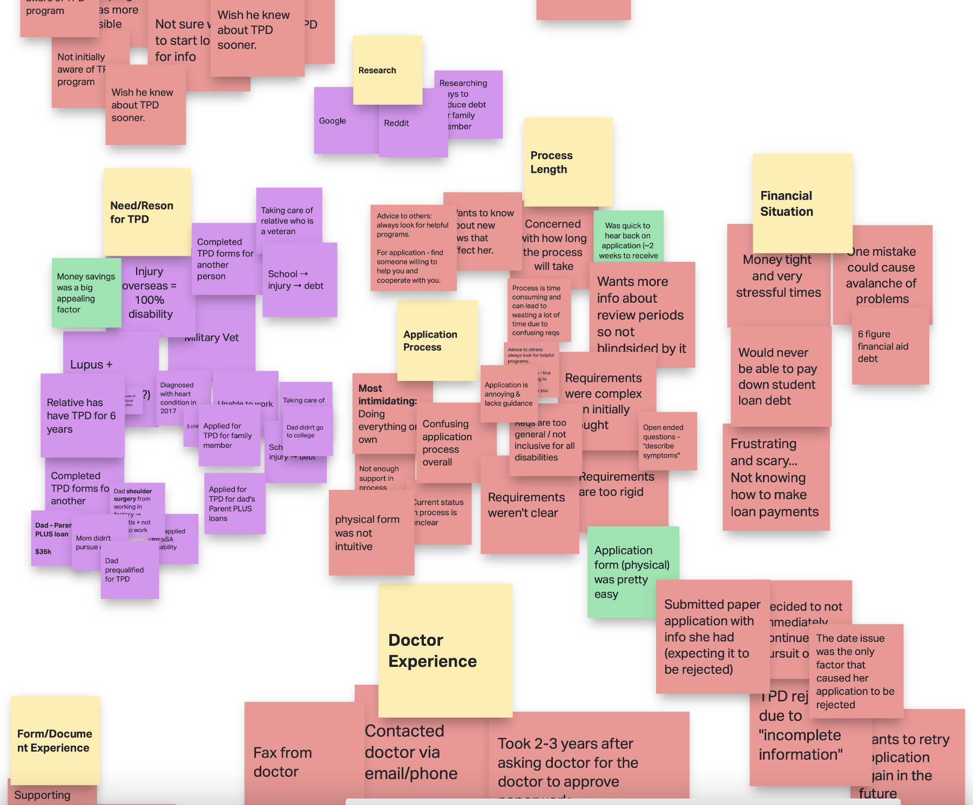
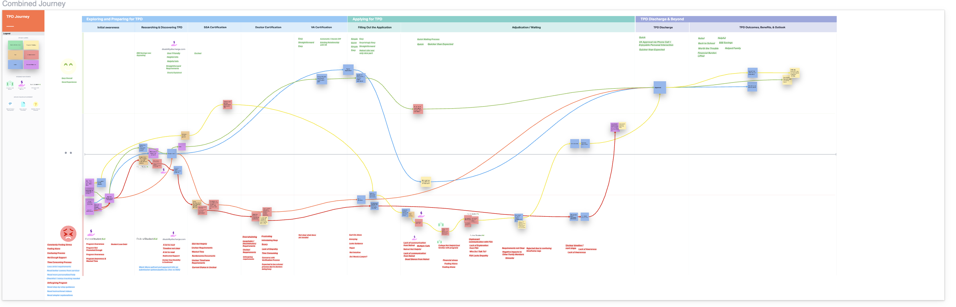
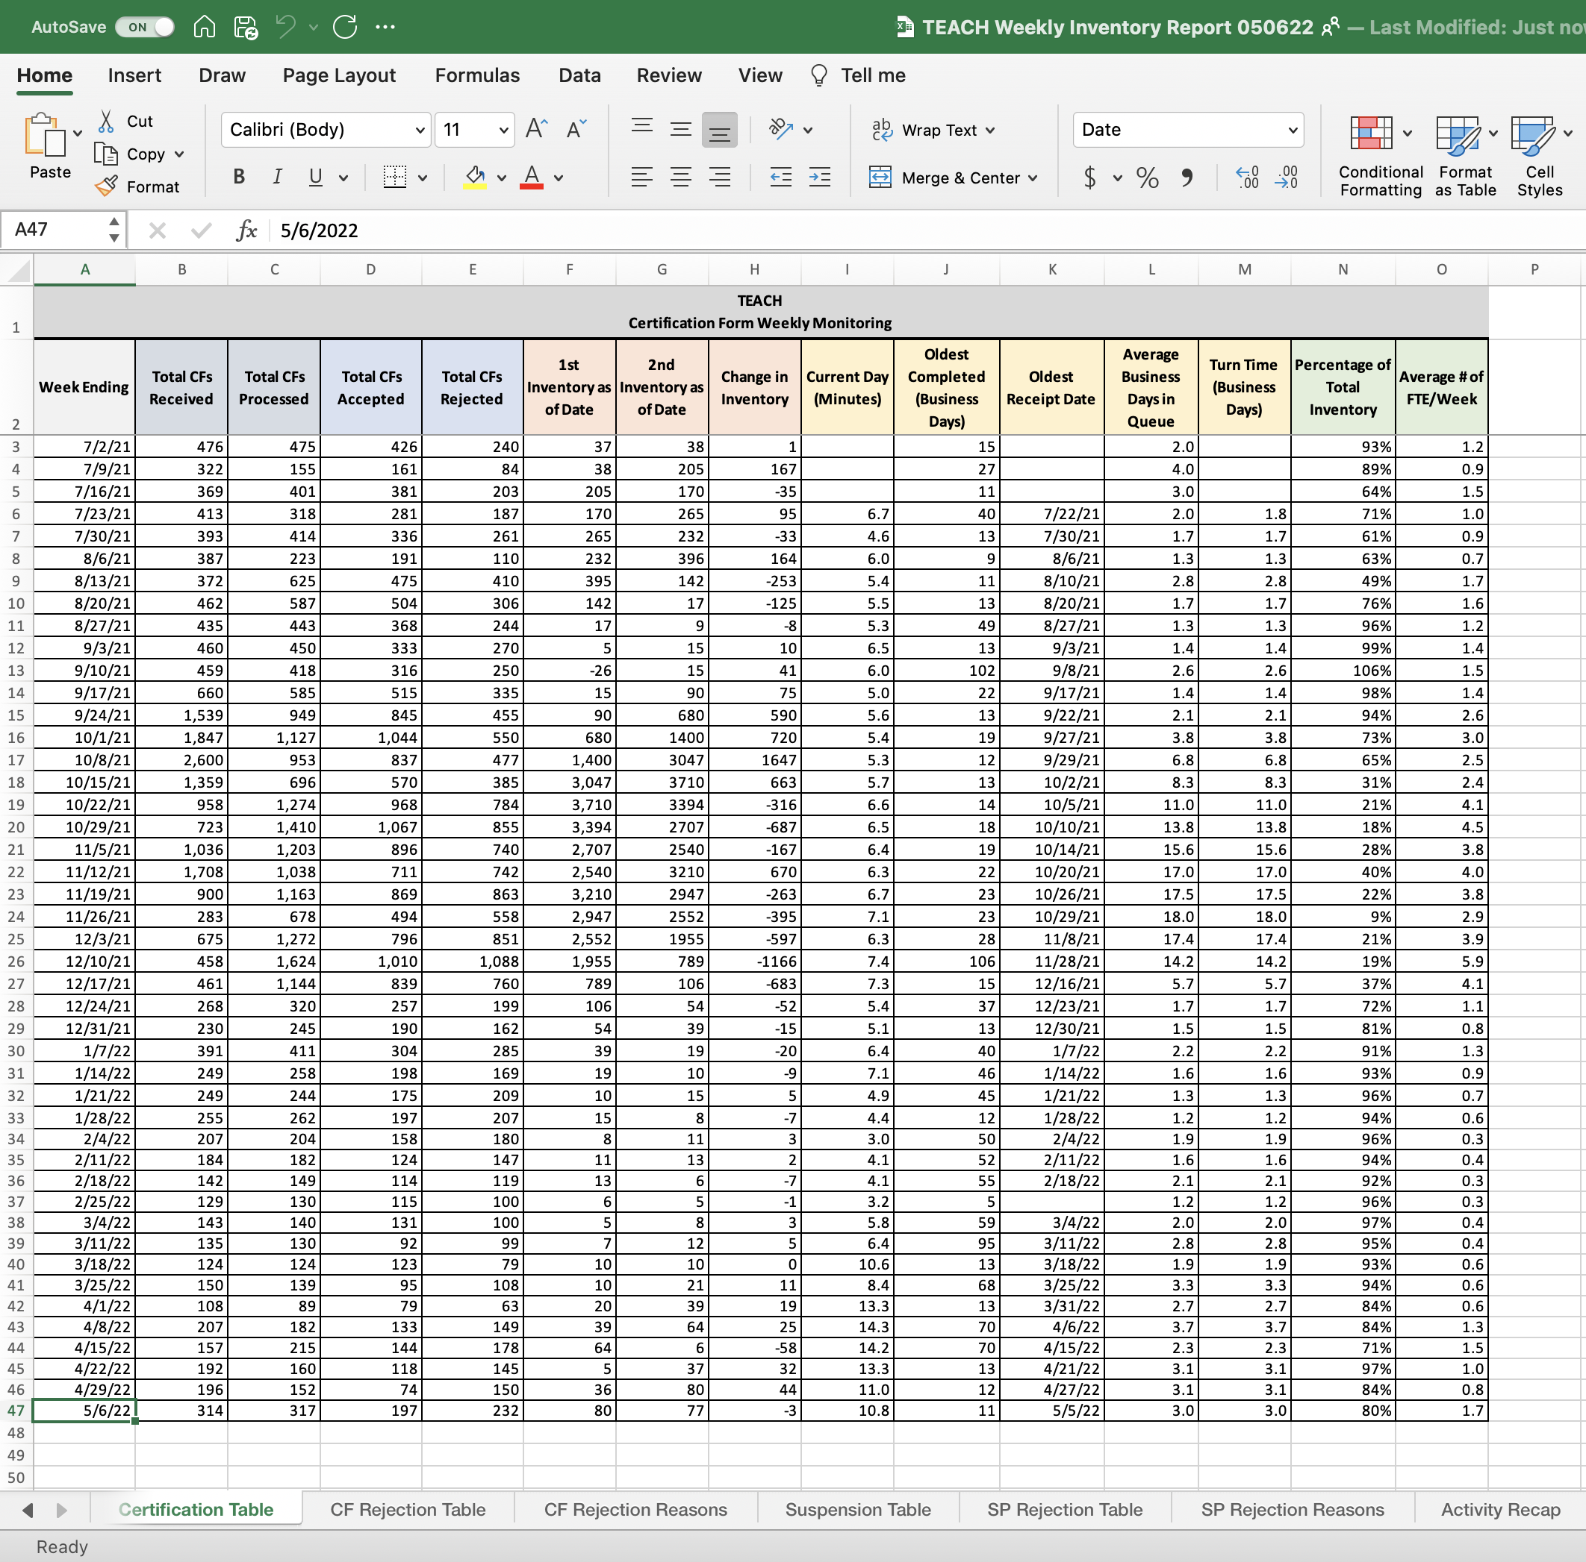
Marrying quantitative data into the analysis
Utilizing qualitative and quantitative data together: Let qualitative data help to put quantitative data into context.

Slide 10
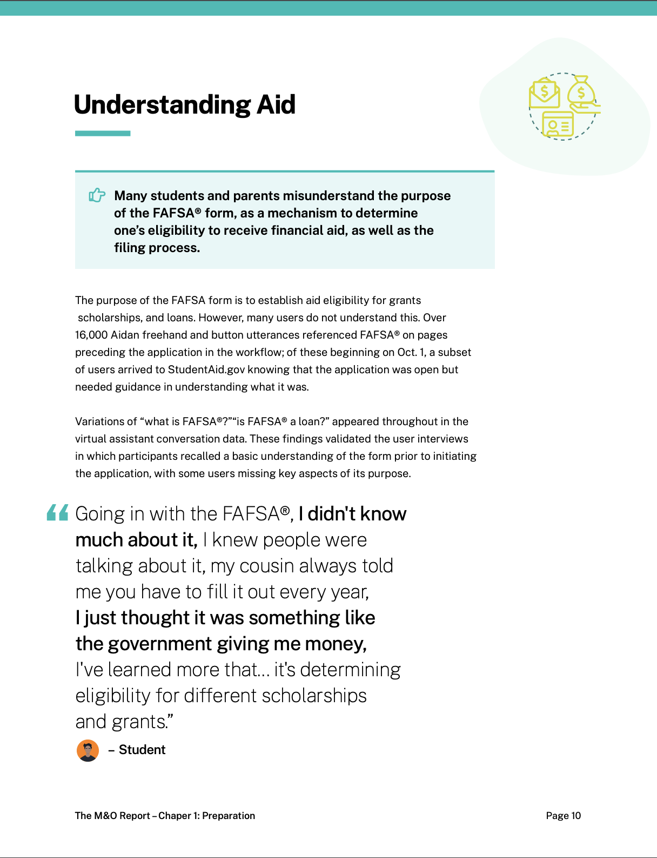

The Output
Research Output for Q1: 25+ page report on the pre, during, and post experiences
of students and parents applying for financial aid.

Slide 11





Putting this all Together: Research in Action
Do a customer data audit: write out all the sources of data you may be able to get a hold of and start to develop relationships with those data owners.
This takes time and you can’t deliver the moon in 4 weeks. Give yourself the appropriate timelines.
Understand the business: partner with a program owner/manager to answer all your questions.
Do your analysis and synthesis in the open. Invite stakeholders in and make them feel part of the process.
Determine your audience’s needs and cater your deliverable toward them. Work with UX designers to develop recommendations that are actionable and human-centered.

Slide 12

Thank yoU!
Send us a note, a tip, or request at FSAProductDesign@ed.gov
Notes:
Image Source: Federal Student Aid

